Slide 1
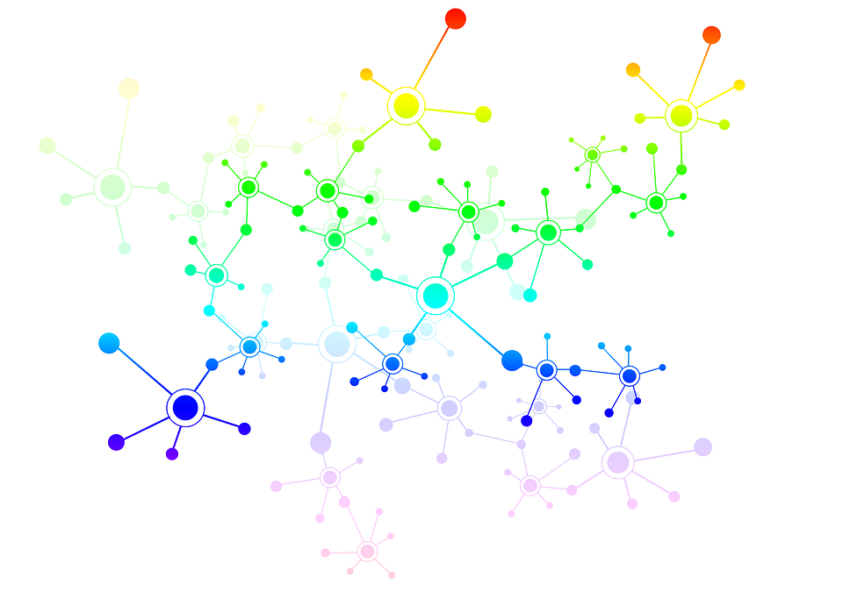
Feed-Forward Networks

Slide 2
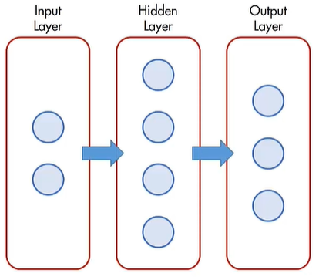
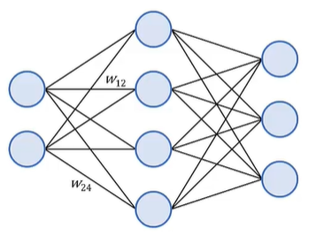
What are Feed-Forward Networks?
The neurons in a feed forward neural network are arranged in layers:
Input layer
Hidden layer/s
Output layer
Information is passed (or fed forward) from one layer to the next
Each neuron is connected to every neuron in the previous and the next layer
Neurons within a layer are not connected
The strength of the connection between any two neurons is giving by a numeric weight value
These networks are also called fully connected networks or vanilla networks
Notes:
FF Networks can have multiple hidden layers.

Slide 3
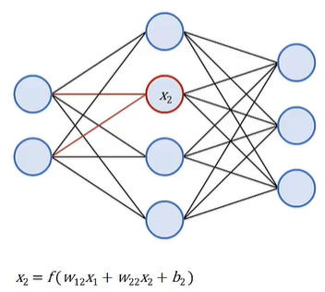
Neuron input value
The value passed to a neuron is calculated by calculating the sum of all the values of the neurons in the previous layer, multiplying them by the appropriate weights, and adding an offset (bias)
This function is known as the transfer function
The output from the transfer function is the input for the activation function within the neuron
The weights, biases and transfer functions determine how inputs are transformed into outputs
Notes:
In this slide, the math operations performed in each neuron are explained

Slide 4
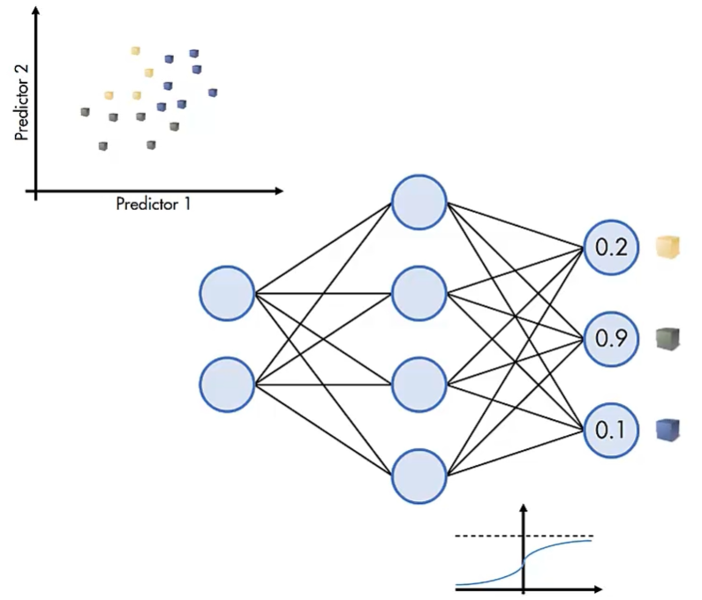
Architectural Details
For classification problems, an appropriate network has :
n input neurons—one for each predictor variable
one output neuron for each response class
Typically, the final transfer function is chosen to map values to the range zero to one
The value of each output neuron is then interpreted as the degree to which the network predicts that the observation comes from that corresponding response class
Notes:
An appropriate network for a classification problem should have:
n input neurons (one for each predictor variable)
an output neuron for each response class

Slide 5
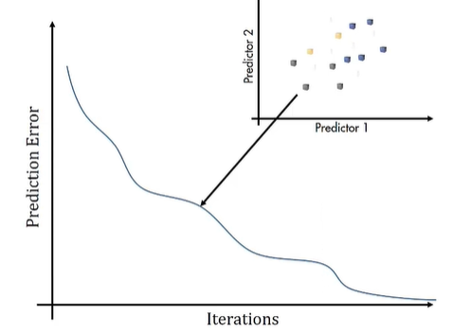
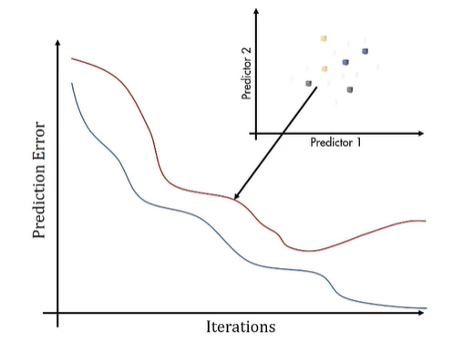
Training a feed forward network
Training a feed forward network involves adjusting the network parameters (weights and biases) to match the training data
This can be achieved by applying an optimization routine that minimizes the prediction error
Overfitting is a common problem and means that the model “memorizes” instead of “generalizing” or “learning”
Using a training and validation partition of data during the training phase may avoid over-fitting
Training data is used to update the parameters by applying the optimization routine
After each iteration, performance is evaluated on the validation data
When validation errors start to increase, training phase should be stopped because the network is no longer generalizing well
Notes:
Training a feed-forward network is an iterative process, that is an optimization routine that minimizes the prediction error.
A validation set is used to determine when the model does not learn anything and needs to be changed.

Slide 6
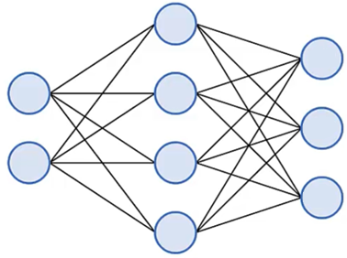
The back-propagation algorithm
The error between the predicted and actual outputs can be measured only for the last layer
Indeed, the only information provided by the ground truth is the expected value for each training sample
The back-propagation algorithm allows the evaluation of the error between the produced and the “expected” output in all the layers
This is possible by back-propagating the error from the output layer to the input one, while also leveraging the chain rule for the evaluation of the derivatives
Actual class
GT
Predicted output
Notes:
A common error is to consider the backpropagation algorithm as the training procedure for ANN. This is not correct, since backprop is actually just a smart and computationally efficient way to evaluate a series of derivatives for a set of nested functions. The algorithm that makes ANN able to learn is the gradient descent.

